Slide 1

Qualifying Autonomous Systems: Learning from Mario Kart for Robust Safety
Presented by Kristy Sakano | October 9th, 2024 | Project in collaboration with Joe Mockler and Dr. Mumu Xu (advisor)

Slide 2
What is the problem?
Given an unknown autonomous system, how do we verify/quantify that the system is safe?
Assurances
Verification & Validation
Safety
🛡️
🗹
🔍
Problem Definition
Current Challenges and Gaps
Experimental Setup & Design
Notes:
Main question: Given an unknown autonomous system, how do we verify/quantify that the system is safe?
This talk is going to touch on themes of safety, assurances, and Verification & Validation (V&V).
Safety in autonomous systems ensures that the system operates without causing harm, staying within defined limits to protect users, property, and the environment.
Assurances provide the evidence and confidence that an autonomous system meets all required safety, reliability, and performance standards under a variety of conditions.
And lastly, V&V refers to the process of vigorously testing and analyzing a system to ensure it behaves as intended (which is the verification), and meets the user’s needs in its operational environment (validation).

Slide 3
What is the problem?
Given an unknown autonomous system, how do we verify/quantify that the system is safe?
What is considered ‘safe’? What is considered ‘unsafe’?
Problem Definition
Current Challenges and Gaps
Experimental Setup & Design
Notes:
The first sub-question: To define safe behavior, we will need something called ‘specifications’, which are a set of rules or constraints that a system must obey. If a system violates the specification, then there is no guarantee of safety, and the system may move to an unsafe state. This can loosely be defined as specification construction, which is the idea of formally defining the desired behaviors and safety requirements that an autonomous system must meet.

Slide 4
What is the problem?
Given an unknown autonomous system, how do we verify/quantify that the system is safe?
What is considered ‘safe’? What is considered ‘unsafe’?
How do we ensure that we’re always operating within specifications?
Problem Definition
Current Challenges and Gaps
Experimental Setup & Design
Notes:
The second question: We may throw a whole bunch of weird scenarios at our system, and we want it to always be operating safely – how do we know this? In practice, one way to address this is to verify that the system’s actions complies with all specifications during its operations. It can be loosely defined as specification satisfaction.

Slide 5
What is the problem?
Given an unknown autonomous system, how do we verify/quantify that the system is safe?
What is considered ‘safe’? What is considered ‘unsafe’?
How do we ensure that we’re always operating within specifications?
Now that we know that we are operating within specifications, what cascading failures may exist?
Problem Definition
Current Challenges and Gaps
Experimental Setup & Design
Notes:
The third question: A cascading failure is a situation in which an initial failure triggers a chain reaction of subsequent failures, which often amplifies the overall impact. This can cause the system to behave unpredictably and dangerously.

Slide 6
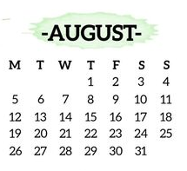
Start Your Engines: The Kickoff Recap 🎮
Two big problems in the safety community:
We don’t have tools to figure out if an autonomous system is safe.
What continual learning systems are being deployed & how do we evaluate it from a perspective of safety?
Problem Definition
Current Challenges and Gaps
Experimental Setup & Design
Notes:
Our primary Person of Contact at NAWCAD, Mr. George Hwang reported on his recent trip to the Annual International System Safety Summit earlier that month.
The primary takeaways from his attendance is that firstly:
We don’t have tools to figure out if an autonomous system is safe.
What continual learning systems are being deployed and how do we evaluate it from a perspective of safety?
To define a continual learning system, these are systems that can learn and make decisions throughout the scenario from a stream of data. In the context of a neural network, you can think of it as a network that can update its parameters in real time, learning on the fly, as it is navigating throughout the environment.

Slide 7
Current Naval Operations: Autonomous Testing 🛩️⚓
Background Information
The Navy acquires numerous autonomous systems annually, ranging from cyber-physical drones to intangible black-box models.
Contractors often define minimal, self-chosen demonstrations.
These demos meet only basic requirements & are tested on limited missions, without exploring broader scenarios.
[3], [4]
Problem Definition
Current Challenges and Gaps
Next Steps and Future Directions
Notes:
I reached out to a friend who works in test & engineering of AI systems to ask him for the current status of AI and autonomous systems testing in the Navy. This is what I learned:
Firstly, the Navy acquires numerous autonomous systems annually, ranging from cyber-physical drones (where the AI is built to the specific drone’s specifications) to intangible black-box models that are the decision-making pieces.
Secondly, contractors will often define minimal, self-chosen demonstrations based on the program’s requirements. For example, if the program requires that the AI be able to handle a precision payload delivery, then the scenario will be written such that there are no perturbations in the environment, no obstacles nor people that may obstruct the mission. That is because these demonstrations are designed to meet the bare minimum requirements. Unfortunately, this reflects prospect theory in action – contractors prefer to meet only the bare minimum requirements with no risk of failure, rather than striving for more ambitious outcomes that carry even a slight chance of failure.

Slide 8
Current Naval Operations: Autonomous Testing 🛩️⚓
Background Information
The Navy acquires numerous autonomous systems annually, ranging from cyber-physical drones to intangible black-box models.
Contractors often define minimal, self-chosen demonstrations.
These demos meet only basic requirements & are tested on limited missions, without exploring broader scenarios.
Problems
Costly: A new system is needed for every scenario.
Lack of Diversity: Systems aren’t tested across various mission types.
Lack of Safety Assurances: No formal verification of safety in unknown or untested situations.
[3], [4]
Problem Definition
Current Challenges and Gaps
Next Steps and Future Directions
Notes:
1. A new system is needed for every scenario, which is costly for the government and is very inefficient.
2. there's a lack of diversity in demonstrations due to loss aversion—the fear of failing a high-risk, high-reward test outweighs the potential satisfaction of success. As a result, systems are tested only on a narrow set of scenarios, limiting the scope of mission types explored.
3. there are no safety assurances currently being conducted, ie; no formal verification of safety in unknown or untested scenarios.

Slide 9
Minimum Requirement #1
Minimum Requirement #3
Minimum Requirement #2
Operational Design Domains (ODDs) 🤝 Scenarios
[1]
Problem Definition
Current Challenges and Gaps
Experimental Setup & Design
Notes:
You may be wondering how the Navy generates these minimum requirements used during testing. Well, they’re pulled from something called an Operational Design Domain, or an ODD for short.
Note: Mumu suggested I de-emphasize ODDs in the talk, putting it last (or even in referential slides)

Slide 10
Operational Design Domains (ODDs) 🤝 Scenarios
ODDs define the specific conditions and environments in which an autonomous system is designed to operate safely.
Scenarios represent individual instances or situations within these ODDs that test the system’s behaviors under various circumstances.
[1]
Problem Definition
Current Challenges and Gaps
Experimental Setup & Design
Notes:
In a brief summary, ODDs define the specific conditions and environments in which an autonomous system is designed to operate safely. In contract, scenarios represent individual instances or situations within those ODDs that test the system’s behavior under specific circumstances.

Slide 11
Operational Design Domains (ODDs) 🤝 Scenarios
Environment: 🛣️ or 🏙️ , but not 🏖️
Weather: ☀️ or ☁️ or 🌧️ or 🌩️, but not🌨️
NPCs: 🚶 or 🚴‍♂️ or 🚗, but not 🏇
Problem Definition
Current Challenges and Gaps
Next Steps and Future Directions
Notes:
For example, an ODD for my autonomous car could be that it can operate on suburban roadways or urban roadways, but not at the beach. It can handle sunny, cloudy, rainy, or thunderstorm weather, but not snow. And it can detect and avoid pedestrians, bikers, other cars, but not people on horseback.

Slide 12
Operational Design Domains (ODDs) 🤝 Scenarios
Environment: 🛣️ or 🏙️ , but not 🏖️
Weather: ☀️ or ☁️ or 🌧️ or 🌩️, but not🌨️
NPCs: 🚶 or 🚴‍♂️ or 🚗, but not 🏇
Problem Definition
Current Challenges and Gaps
Next Steps and Future Directions
Notes:
And the specific scenario I’ll be using for my first test will be on a suburban road, under cloudy conditions, with bikers and other cars, but perhaps no pedestrians. I’ll also specify what the map of the area looks like, and the specific number of other characters or obstacles I’ll encounter, and where I might experience them.
In essence, ODDs provide the boundaries, and scenarios explore the system’s performance within those boundaries by looking at snapshots.

Slide 13
What should our experiments & system look like?
Open-Source Simulation Engine
What currently exists? CARLA, VISTA 2.0, SUMMIT, FLOW, Mario Kart, to name a few… [2]
Fixed (or Static) Learning System
We shift to models that once deployed, do not update or adapt their models in real time.
Continuous Learning Systems
Given the abridged timeframe, this might be good for a follow-on project.
Problem Definition
Current Challenges and Gaps
Next Steps and Future Directions
Notes:
Given this short background, we started thinking about what sort of problems we wanted to tackle, in general.
While we originally set out to address continuous learning systems, the 1-year timeframe is very short for learning about continuously learning systems and implementing them, which can be challenging to do. We also would need to pick between batch learning, active learning, incremental learning, etc., and given that we want to focus primarily on the safety assurances side of the project and not the system development side, we decided to opt for a static learning system.
Also known as a fixed learning system, these systems are trained in a controlled environment (often offline) and once deployed, they do not update or adapt their model in real time. Rather, they rely solely on the knowledge learned during the initial training phase without any further modification or improvement after deployment.
We started investigating Open-Source Simulation Engines. These are simulators that provide researchers with a testbed to experiment with new algorithms, test safety and performance, and support benchmarking for replication or comparison of past works.

Slide 14
⚙️ Chain Reaction: How One Misstep Violates the Specs 🔗
Cascading failures can lead to specification violation.
Misjudge a turn
Bump into track wall
Lose speed & alignment
Overcorrect
Specification Violation
🙅
Problem Definition
Current Challenges and Gaps
Next Steps and Future Directions
Notes:
In the process of our discussions, we kept coming back to cascading failures. I mentioned this at the start of my talk, but to reiterate, a cascading failure is a situation in which an initial failure triggers a chain reaction of subsequent failures. Cascading failures are often discussed in the context of specification violations, which I’ll elaborate here.
The first way in which they’re linked is that cascading failures can lead to specification violations. Imagine you’re racing on Rainbow Road, and the system is supposed to follow certain specifications, such as a speed limit and safe turning angle to avoid falling off the cliff. But you misjudge a turn and you bump into the track’s wall, which could cause you to lose some speed an alignment. In an attempt to recover, you accelerate quickly and steer sharply to get back on track, but this overcorrection causes you to lose control. As a result, you’re going faster than the 60 mph safety specification for the track & taking turns at angles sharper than what is allowed.
The sequence of small mistakes – bumping into the wall, oversteering, and speeding – form a cascading failure, where each action builds on the last. Eventually, this forces you to operate outside of the safe system specifications, leading to a specification violation. The result is a critical failure, like flying off the track.

Slide 15
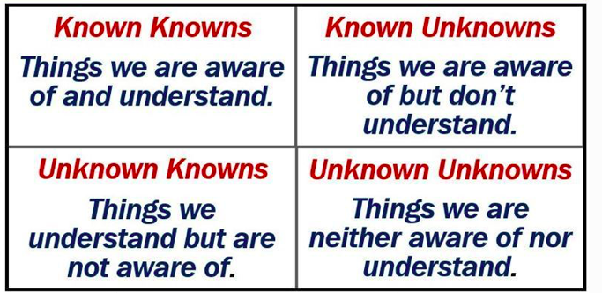
⚙️ Chain Reaction: How One Misstep Violates the Specs 🔗
Cascading failures can lead to specification violation.
Cascading Failures without Direct Specification.
Problem Definition
Current Challenges and Gaps
Next Steps and Future Directions
Notes:
Secondly, we may have cascading failures because we may include components or interactions that are not captured by the system’s formal specifications. We may have unexpected interactions between modules or external disturbances that aren’t covered by the predefined specifications. These types of failure are hard to predict and mitigate because we don’t know to predict them ahead of time, since we don’t know what they are.

Slide 16
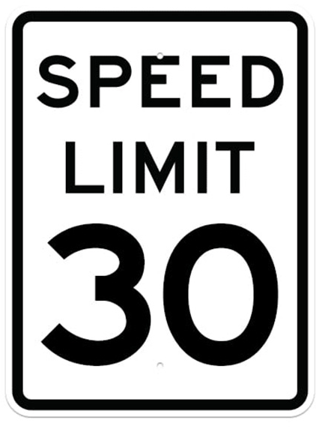
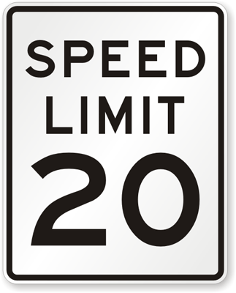
⚙️ Chain Reaction: How One Misstep Violates the Specs 🔗
Cascading failures can lead to specification violation.
Cascading Failures without Direct Specification.
Specification Violations as early indicators.
or
Problem Definition
Current Challenges and Gaps
Next Steps and Future Directions
Notes:
The last interaction I’ll cover may be that detection of a specification violation early can prevent cascading failures. For example, if we have tight bounds on our specifications, we can catch & correct the system’s behavior when it first violates these specifications, and it may stop the cascade before it grows into a larger failure.

Slide 17
Defining our Experiment: The Iterative Cycle 🔄
Construct Local Specifications for Scenario
Simulate Scenario
Collect Performance Data
Identify Cascading Failures
Problem Definition
Current Challenges and Gaps
Next Steps and Future Directions
Notes:
This finally brings us to my vision for our experimental design. We’ll start by taking the global rules as defined in the ODD and constructing local specifications for our particular scenario.
We’ll then simulate the scenario in our chosen simulator, and observe how the system follows the specifications in real-time gameplay. We may iterate this a couple dozen or hundred times with slightly varying initial parameters.
We’ll then monitor the system behavior by collecting data on performance like speed, drift, number of times it goes off the cliff, etc. We’ll track deviations, small errors, and potential overcorrections.
Lastly, we’ll pinpoint mistakes that lead to escalating issues, such as bumping a wall that leads to oversteering. We’ll adjust our specifications based on these failure points, such as tightening the turn radius or lowering the speed limit.
This is an iterative loop of constructing specifications and testing them in simulation, creating a continuous loop of improvement as we test and refine our specifications to avoid cascading failures.

Slide 18
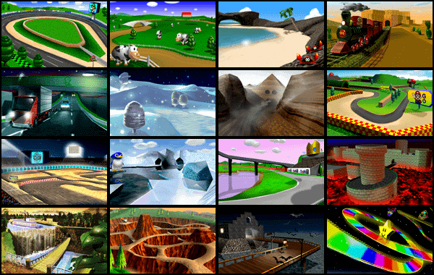
Operational Design Domains (ODDs) 🤝 Scenarios
Scenario Specific Features
No other NPCs
No non-recoverable cliffs
Sample Specification
No >60 mph
Must be <30 mph on curves
No drifting
[1]
Problem Definition
Current Challenges and Gaps
Next Steps and Future Directions
Notes:
So how does this pertain to Mario Kart?
Well, we’ll use ODDs as the frameworks for the test and scenarios that we want to do. For example, maybe these tracks are all the ones that according to our ODD, we should be able to handle.
We’ll pick a specific scenario and define our scenario-specific features. We’ll then start with some sample specifications, and ensure that our ML-based autonomous system is adhering to them. We’ll then simulate our autonomous system in Mario Kart, and observe for any cascading failures.
We’ll capture data and quantify what kinds of risks or hazards may appear based on our specifications, and then tighten them as needed. Then, we’ll repeat it all over again.

Slide 19
What Role does the simulator play?
Assurance-based experimentation
Adjusting ML/RL parameters
Focus on building specs, simulating their result
Specification Satisfaction/Violation
Ensuring our specifications are being upheld in a chosen scenario
Identifying points that lead to cascading failures
Editing specifications to avoid them
Iterative Development & Testing
Design specifications, simulate behavior
Independent variable: specifications
Dependent variables: vehicular performance
Data-Driven Approach
No manipulation of ML/RL parameters
Focus on mathematical & formal verification on specifications based on actual performance data
Specification Construction
From pre-existing state-space data, infer specifications by operating safe operating boundaries & failure points
Post-Mortem Analysis
Use publicly available state space data
No experimentation on simulators
Disclaimer: This is my interpretation of the project! Our specific implementation (ie: how do we integrate formal specifications into an autonomous system) has yet to be defined.
Problem Definition
Current Challenges and Gaps
Next Steps and Future Directions

Slide 20
References
1. ODD and Behavior Based Scenario Generation for Automated Driving Systems
2. Top 8 Autonomous Driving Open Source Projects One Must Try Hands-On
3. Prospect Theory & Political Science
4. Interview with a T&E Engineer in the AI & Autonomy Development Branch, NAWCAD
Notes:
PS: I got my slides as SlidesGo – you can download one free template each month.

